Slide 1




COFFEE, CULTURE, AND METAL: A GLOBAL EXPLORATION
Unveiling Quirky Connections Through Data
~ Hitesh Choudhary

Slide 2
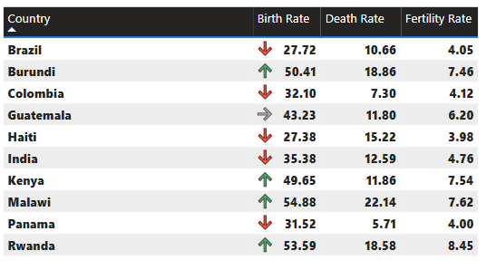
DEMOGRAPHICS REPORT
HIGHEST
AVERAGE
LOWEST
The countries with the highest birth rates are Burundi (50.41) and Malawi (54.88). These countries also have high death rates (18.86 and 22.14 respectively).
Brazil (27.72) and Colombia (32.10) have birth rates that are above the global average around 18 births per 1,000 people according to World Bank but lower than some of the African countries listed. Their death rates are also lower than the African countries.
Panama (31.52) has a birth rate that is closer to the global average and a very low death rate (5.71).
+19K

Slide 3
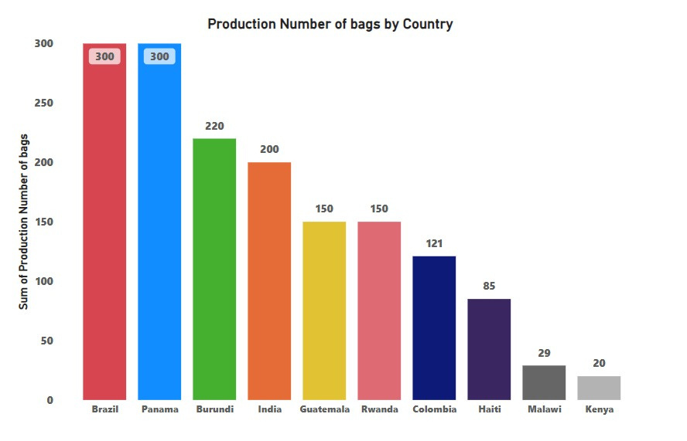
MARKET SHARE IN PRODUCTION
Brazil & Panama is the top producer of bags, with a production number of 300.
Burundi & India is the second & third largest producer, with a production number of 220 and 200 respectively.
Guatemala and Rwanda all have a production number of 150.
The remaining countries - Colombia, Haiti, Malawi, and Kenya - have a production number that falls below 150.

Slide 4
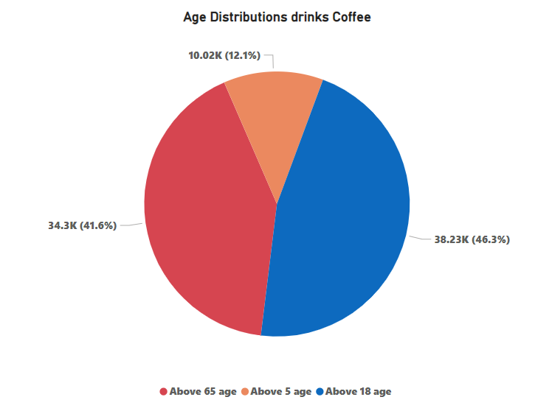
AGE DISTIBUTIONS
ANALYTICS
The largest percentage of coffee drinkers, 46.3%, fall into the 18-50 age range.
People over 65 years old make up the second largest group of coffee drinkers at 41.6%.
The smallest percentage of coffee drinkers, 12.1%, are under 18 years old.

Slide 5
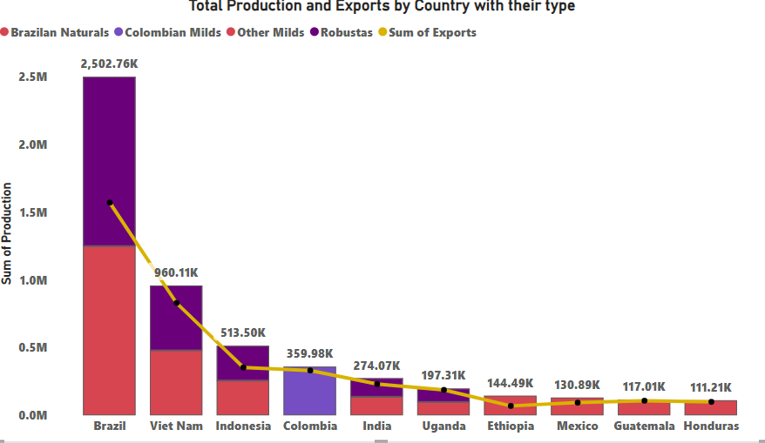
PRODUCTION AND EXPORTS
ANALYTICS
Brazil is the leading producer by a significant margin, with a total production of 2.5 million tons. It also exports the most, at nearly 2.5 million tons.
Colombia produces 2.3 million tons but exports only 960,110 tons. This suggests that Colombia consumes a larger portion of its own coffee production domestically.
Vietnam exports 513,500 tons and Indonesia exports 359,980 tons of Brazilian Naturals coffee beans.

Slide 6
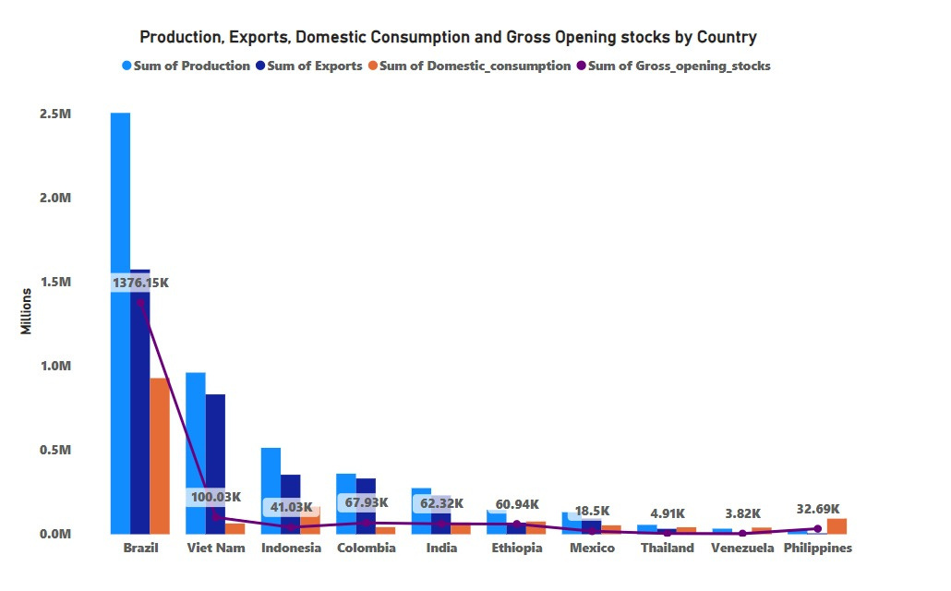
DOMESTIC CONSUMPTION & PRODUCTION
ANALYTICS
Brazil's Dominance: Brazil is the leading country in all four categories by a significant margin. It has the highest production, exports, domestic consumption, and gross opening stocks.
Other Notable Producers and Consumers: While Brazil stands out, other countries also have significant values in some categories. For instance, Viet Nam has a high production value but seems to have lower exports compared to Brazil.
Colombia and Indonesia: Colombia appears to have a production level close to Viet Nam but with lower values in exports and domestic consumption. Indonesia has a lower production value

Slide 7
SUMMARY
Aims to explore quirky coffee consumption patterns globally using secondary data sources. Research focus on correlations between coffee consumption and factors like age demographics and cultural interests. Analysis yield insights on variations in coffee consumption, socio-economic influences, and trends over time.

Slide 8
REFERNCES
https://corgis-edu.github.io/corgis/csv/coffee/
https://www.kaggle.com/datasets/michals22/coffee-dataset
https://corgis-edu.github.io/corgis/csv/county_demographics/
https://www.kaggle.com/datasets/akshatsharma0610/coffee-production-and-consumption-1990-2019

Slide 9
THANK YOU
Hitesh Choudhary

